Slide 1
Utilize UNION operation on given two sets of positive integers to output the sorted array
BISWAJEET DAS (IIT2019019)
SHREYANSH PATIDAR (IIT2019018)
HRITIK SHARMA (IIT2019020)

Slide 2
Absract
This Paper contains the algorithm to Utilize UNION operation on given two sets of positive integers to output the sorted array. Three approaches have been taken and we will see the difference in complexity between both.

Slide 3
INTRODUCTION
Union: the union (denoted by ∪) of a collection of sets is the set of all elements in the collection.
Sorting is the process of arranging the elements of a set in a fashionable order i.e either in ascending or descending order of the elements of the set.
This report further contains -
II. Algorithm Design
III. Algorithm Analysis
IV. Result
V. Conclusion
VI. Result

Slide 4
ALGORITHM DESIGN
Approach 1:
1. Find the maximum number among both the sets (maxALL) by individually getting the max of each set
(maxA: maximum positive integer of set A and maxB: maximum positive integer of set B) and
maxALL = max(maxA, maxB).
2. Iterate over a loop from 1 to maxALL (both inclusive).
3. We check whether i is present in both the sets(A and B) or not.
4. If i is present in both sets A,B then we print i.
5. Answer is printed according to the result of the algorithm.

Slide 5
Algorithm 1:
int maxa=0,maxb=0;
for(i: 1→sizeof(A) ) maxa=max(maxa,A[i]);
for(i: 1→sizeof(B) ) maxb=max(maxb,B[i]);
maxALL = max(maxA,maxB);
for(i: 1→maxALL)
{
if(i in A and i in B)
Insert i in ans_array;
}
print(ans_array);

Slide 6
ALGORITHM DESIGN
Approach 2:
1. Make a new array ans_array.
2. Traverse over array A and check for each element x is present in ans_array or not. If its present then continue, else insert it in ans_array.
3. Insertion here will be based on binary search technique(divide and conquer). We take mid element of ans_array and check whether its greater or smaller than x. If greater,then lower r to be mid-1, else increase l to be mid+1. If we get a position mid such that there exist no element greater smaller than x then we insert x in ans_array at position mid+1.
4. We do the same thing for array B.
5. Finally we are left with the ans in ans_array

Slide 7
Algorithm 2:
for(i : 1→n)
{
int l =1, r= n, pos=-1;
while(l<=r)
{
int mid = (l+r)/2;
if(A[mid]==x)break;
else if(A[mid]<x)pos=mid,l=mid+1;
else r = mid-1;
}
Insert x in pos if pos!=-1;
}
Same in B[].

Slide 8
ALGORITHM DESIGN
Approach 3:
1. Sort both the arrays A and B individually.
2. Make a new array ans_array.
3. Take 2 pointers(pa,pb) one for each array, pointing at the first element of A and B respectively.
4. Check if A[pa]>B[pb] then check if B[pb] is present in ans_array or not. If not then insert B[pb] into ans_array. Increment pb to pb+1
5. If A[pa]<B[pb] then check if A[pa] is present in ans_array or not. If not then insert A[pa] into ans_array. Increment pa to pa+1
6. If A[pa]=B[pb] then check if A[pa] is present in ans_array or not. If not then insert A[pa] into ans_array. Increment pa to pa+1 and pb to pb+1
7. Finally print ans_array.

Slide 9
Algorithm 3:
int p1=0,p2=0;
while(p1<n and p2<m)
{
if(A[p1]<B[p2])
{
if(Search in ans_arr(A[p1]))
continue;
else
Insert A[p1] in ans_array
p1++;
}
if(A[p1]>B[p2])
{
if(Search in ans_arr(B[p2]))
continue;
else
Insert B[p2] in ans_array
p2++;
}
if(A[p1]==B[p2])
{
if(Search in ans_arr(A[p1]))
continue;
else
Insert A[p1] in ans_array
p1++; p2++;
}
}

Slide 10
ALGORITHM ANALYSIS
Approach 1:
Here the maximum value of maxALL can go to maximum value of integer value which is 232- 1.
And each searching operation takes linear time i.e. ∝ n and m.
So the time complexity will be O((maxALL) * (n+m) ).
t_{best} : when n=m=0, = O(0) = 0ms
t_{worst} : when n=m=1000(max limit given) and maxALL = INT_MAX. = O(10¹⁵)= 10¹⁰ ms.
Approach 2:
Here, traversing over each array with size n,m will take time ∝ n and m respectively. Finding mid pos for each element will take log(n+m) time. And insertion operation will take time ∝ n + m.
So, the time complexity will be
O((n+m)*log(n+m)*(n+m)).
t_{best} : when n=m=0, = O(0) = 0ms
t_{worst} : when n=m=1000(max limit given) = O(4*10⁶ * log(2000)) = 1.2 secs.

Slide 11
ALGORITHM ANALYSIS
Approach 3:
Here, traversing over each array with size n,m will take time ∝ n and m. And searching the ans_array with binary search will take log(n+m) time. Insertion takes constant time.
So, the time complexity will be
O((n+m)* log(n+m))
t_{best} : when n=m=0, = O(0) = 0ms
t_{worst} : when n=m=1000(max limit given) = O(2000 * log(2000)) = 0.7ms.

Slide 12
VALUES OF O(N) FOR ALL ALGORITHMS
SNo. | N+M | maxALL | Algo1 | Algo 2 | Algo 3
1 | 0 | 0 | 0 | 0 | 0
2 | 10 | 1000 | 10000 | 230.2585093 | 23.02585093
3 | 20 | 1000 | 20000 | 1198.292909 | 59.91464547
4 | 30 | 1000 | 30000 | 3061.077643 | 102.0359214
5 | 40 | 1000 | 40000 | 5902.207127 | 147.5551782
6 | 50 | 1000 | 50000 | 9780.057514 | 195.6011503

Slide 13
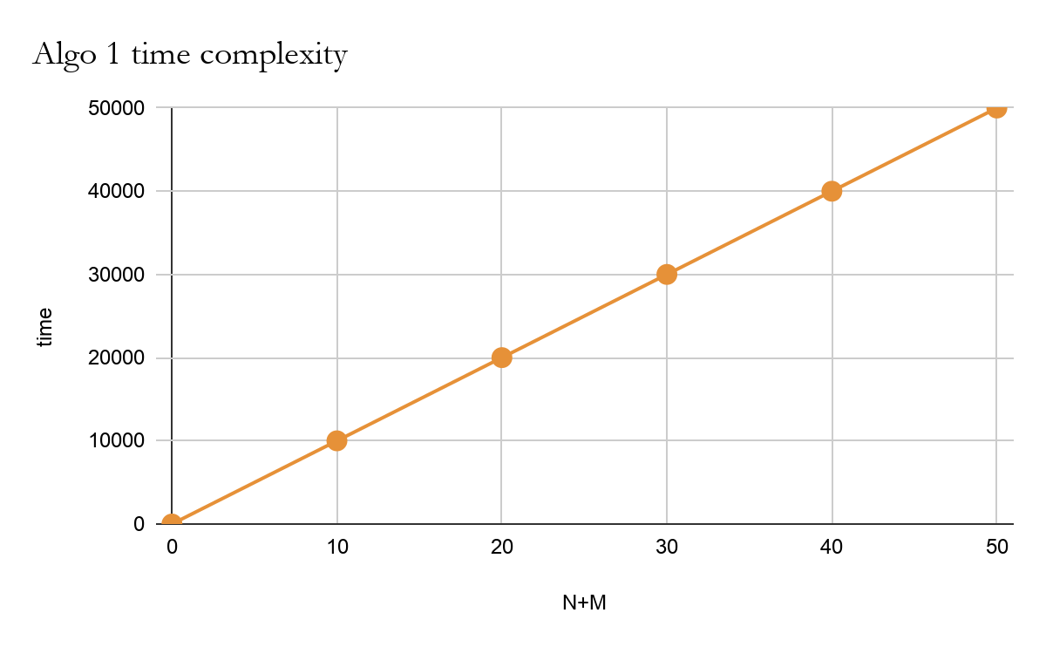
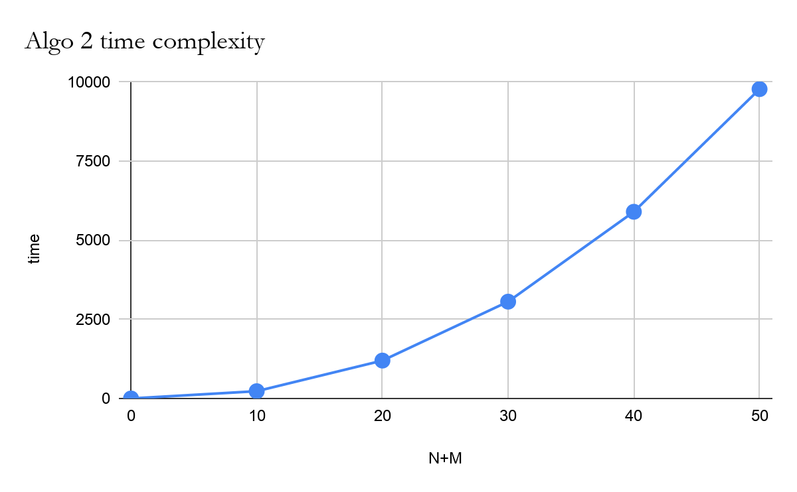
TIME COMPLEXITIES OF ALGO 1 & 2

Slide 14
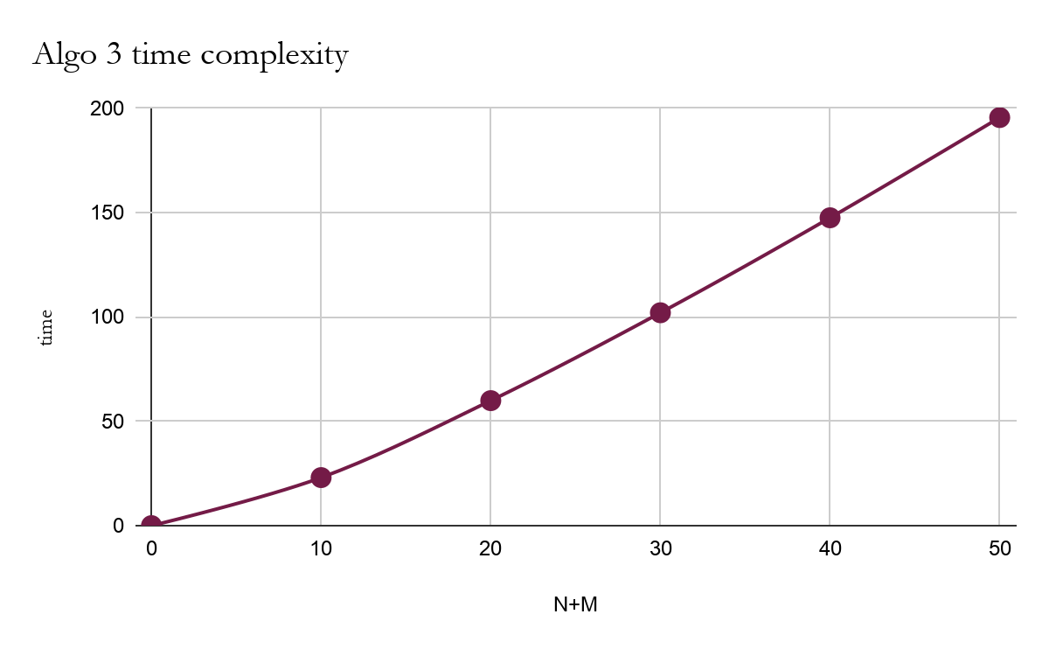
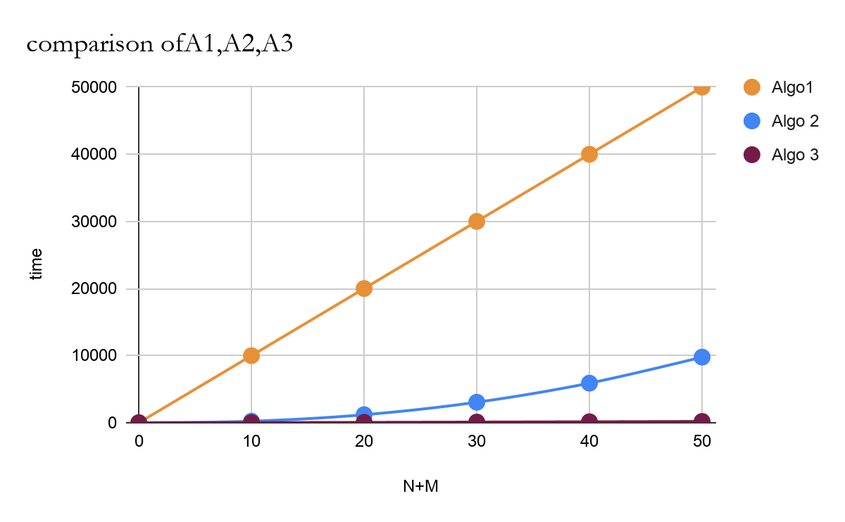
ALGO 3 TIME COMPLEXITY & COMPLEXITY OVERALL

Slide 15
CONCLUSION
All the three methods have different time complexities and meet to fulfill the problem statement. The order in which they are good can be listed as:
I. Approach 3
II. Approach 2
III. Approach 1
Based on the time complexities.

